Slide 1
Release Overview
Welcome! We will get started shortly.
March 2023 Nightingale Notes Release
Presented by: The Champ Team

Slide 2
Agenda/Included in this release
New feature available for Gold customers: SAML/SSO
In this release for all users:
Show prior KBS ratings in Charting
Add Detail level > Activity program and Activity cost center to Reports
Show score questions for all assessment forms in Report
For Minnesota IHVE Users only:
In “New Related Activity,” there is now a Save and Close button, as well as showing a warning, if user is trying to leave screen without saving.
For “Add existing screening” in IHVE, instead of radio buttons, have checkboxes with a “Check All” option.

Slide 3
SAML/SSO
Only available for Gold customers
Using Microsoft login credentials means you will not have to remember a separate password for Nightingale Notes
Password change every 90 days is not needed

Slide 4
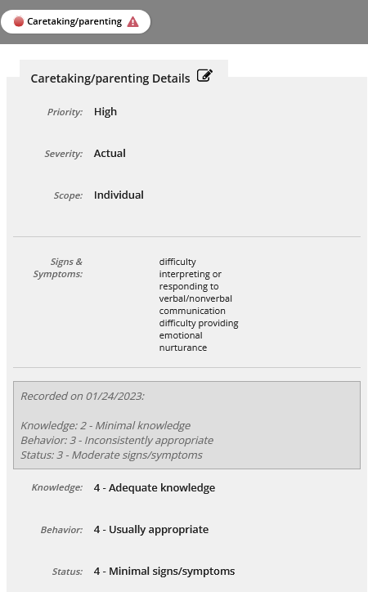
Show Prior KBS Ratings in Charting
When a client has charting, and a problem has KBS being tracked from visit to visit, you will now see the ratings from the most recent prior visit that has any or all of knowledge, behavior and status recorded.

Slide 5
Activity Program and Cost Center is now Available in Reports
In the Ledger Detail report screen, you can now report on and filter by Activity cost center and Activity program.
This allows for the breakdown of activities that have been billed.

Slide 6
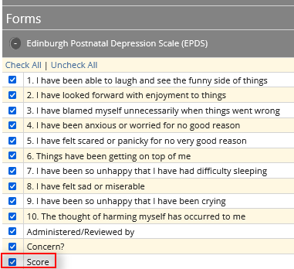
Show Score Questions for all Assessment Forms in Reports
Assessment forms in Nightingale Notes that are scored previously did have a Score field in Reports. It has now been added to the forms that can be scored.
Notes:
Pause and go to the last slide to cover important dates

Slide 7
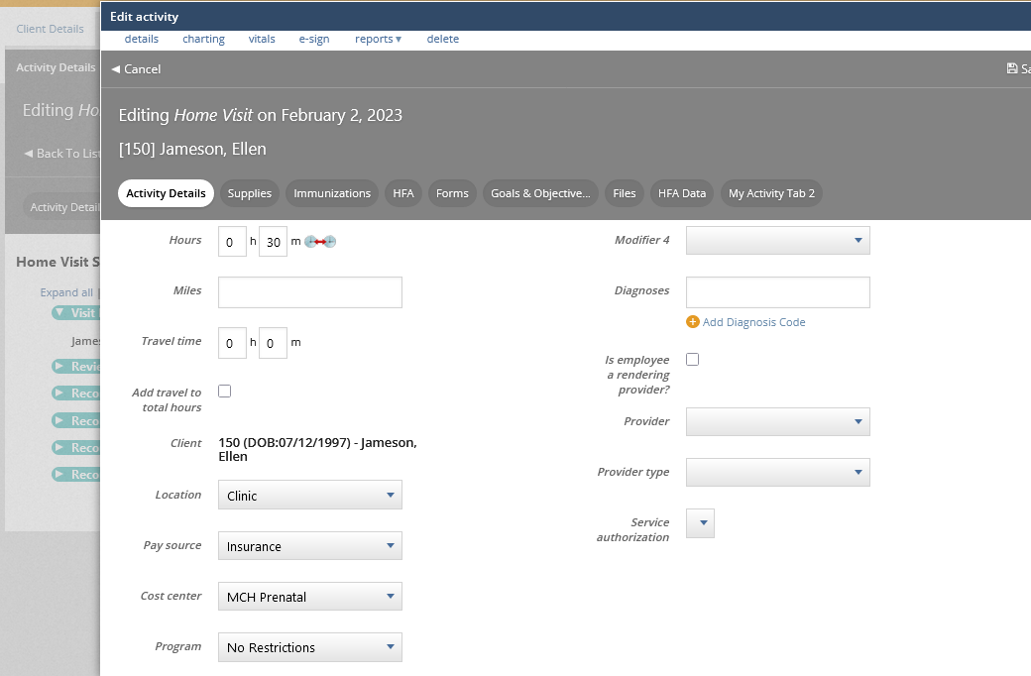
IHVE: Changes to Save Functionality in “New Related Activity”
If you add a “New related activity” from an FHV activity, and you go immediately to the Charting tab or elsewhere without saving, when you go back to Activity Details, the activity info you previously entered will not have saved and there is no warning.
Notes:
When adding a new related activity, and adding charting,

Slide 8
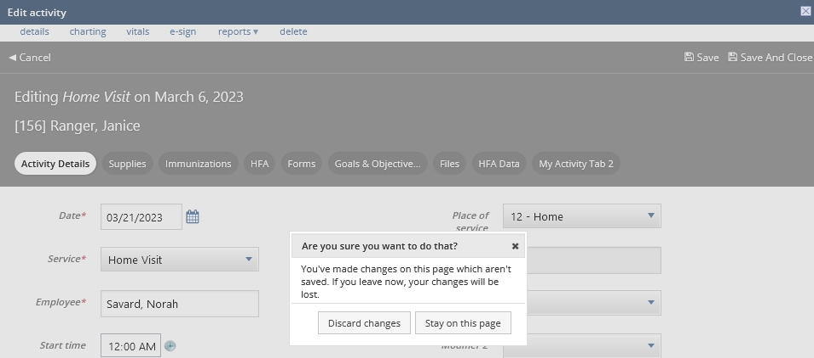
IHVE: Changes to Save Functionality in “New Related Activity”
New behavior: If you attempt to navigate away from the Activity Details screen, such as to go to Charting, Vitals, etc., you’ll get a warning that you will lose your changes:
Notes:
When adding a new related activity, and adding charting,

Slide 9
IHVE: Changes to Save Functionality in “New Related Activity”
Also notice the “Save” and “Save and Close” buttons. Previously “Save” would close the popup window and you would have to navigate back. Now, it will keep you on the screen so you can navigate where you want to go. To leave the screen, click on “Save and Close.”
Notes:
When adding a new related activity, and adding charting,

Slide 10
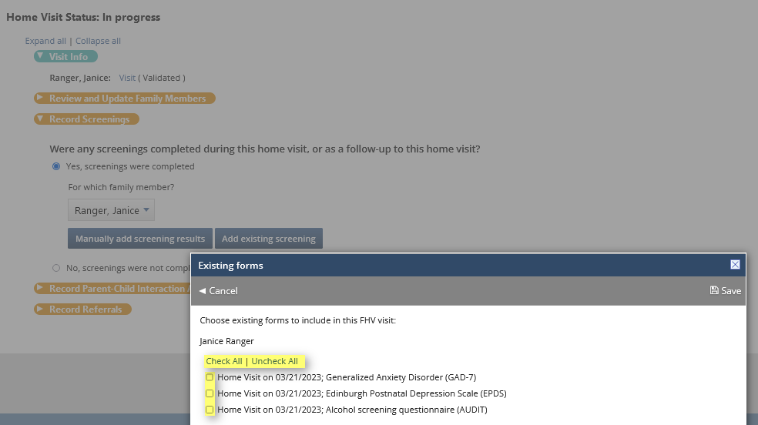
IHVE: Radio Buttons now Checkboxes with “Check All” in “Add Existing Screening”

Slide 11
Q & A
Notes:
Is there a resource I can use to test the strength of my password? i.e. that would tell me if it is weak or strong.
“How is it possible that only four random words are that complex?”
How are wearable chips used?
What does block chain mean? Is it a type of data?

Slide 12
Important Dates
This update is currently on staging:
Use your Nightingale Notes credentials to log into: https://staging.nightingalenotes.com/
Release to production on Friday, March 31st, at end of business day.
You can test any of these updates on staging:
Staging database: https://staging.nightingalenotes.com/

