Slide 1
July 2023 Release Overview
Presented by:
Kellie Kopischke

Slide 2
Release Includes:
Default Service Assigned to User
Extended BMI Growth Charts for Obesity
Historical Vitals - Disable Fields that are Currently Enabled
Change to Sorting Order in Pathways
MN IHVE Users Only - "No change in residence" Option added to Intake Form
Gold Package Customers Only - Updates for Custom Forms Feature

Slide 3
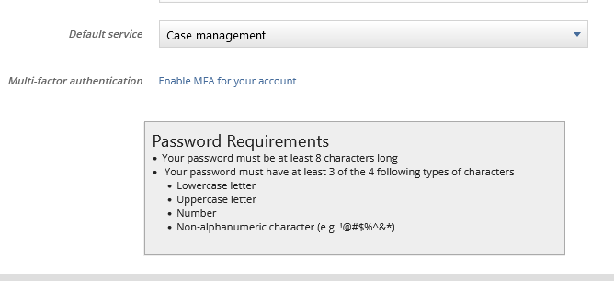
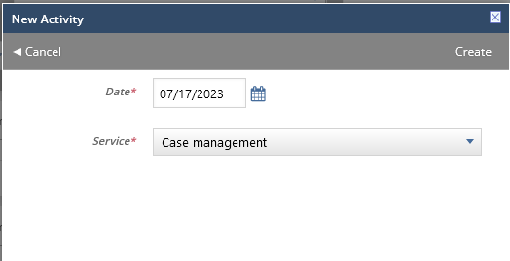
Default Service Assigned to User
In Setup > Employee > Employee Information:
When creating activity, service autofills:

Slide 4
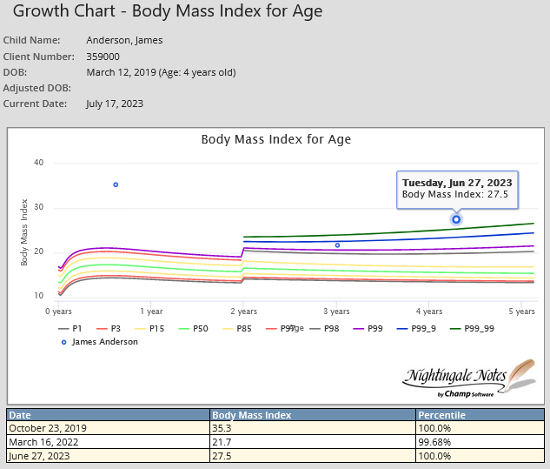
Extended BMI Growth Charts for Obesity
The CDC has published information about new extended growth charges for obesity. Following the new guidelines, we have adjusted the BMI to show 88, 99, 99.9 and 99.99 percentile:

Slide 5
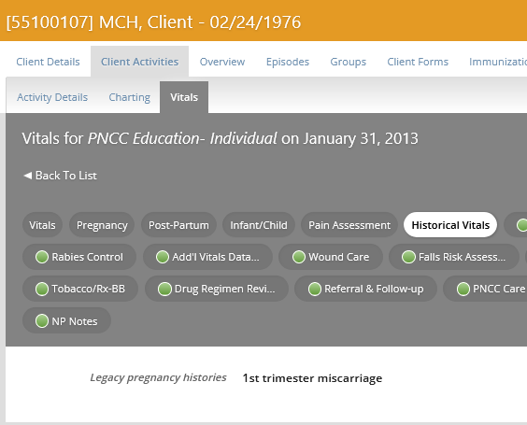
Historical Vitals: Disable Fields
This field used to show up in Vitals all the time:
It contained several Vitals fields which are no longer captured in Nightingale Notes. These fields were disabled – for informational purposes only. However, some of the fields were enabled, allowing users to enter data.
We have now changed it, so that the enabled fields are not enabled anymore and only show up for previous activities that had data entered in those fields.
Otherwise, the tab does not display in any activities.

Slide 6
Change to Pathway Sorting Order:
It had come to our attention when creating new pathways, agencies were experiencing random ordering of the pathways within a client record as well as within Setup. It has always been practice that pathways order themselves within a given Omaha System Problem and Category and has not changed. Interventions are now alphabetized within a given Problem and Category. Your guides will, however, remain in whatever order you place them within a given Problem/Category/Intervention.

Slide 7
MN IHVE Users Only – “No change in residence” Option:
New Question at bottom of Primary Caregiver Intake Form > Demographic pill.
For existing forms, the question is skipped.
For new visits, it is also skipped until the 6 month demographic update is due, when it becomes required.
When the 6 month update is due, the most existing answer (on or before the current visit date) for each demographic question is copied forward.
When the 6 month update is not due, then the form continues to populate “not asked at this visit” as before.

Slide 8
Custom Forms Updates
Gold Package Customers Only

Slide 9
Reconcile Demographic and Subscriber Info:
When data from the Demographic or Subscriber blocks is different from what was previously entered, you can choose to update it, by selecting “Use this value:”
It will then update the client record with the new data, when form is saved.

Slide 10
New Processed Forms Tab:
On this tab in Manage Custom Forms, you can view the client form, by clicking on the View Form icon in the Options column
Or you can click on Client Details button to be brought directly to the client record.
Each form can be accessed from this screen for 7 days after form has been submitted.

Slide 11
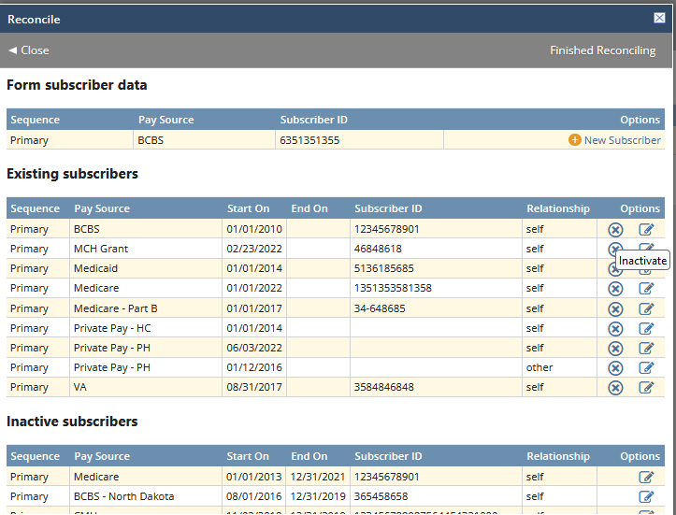
Subscriber Info Changes:
When a form is created using a Subscriber block, when reconciling the data in the form, new subscriber info can be saved as a new Subscriber.
Existing subscribers can also be inactivated by clicking on the “X.”

Slide 12
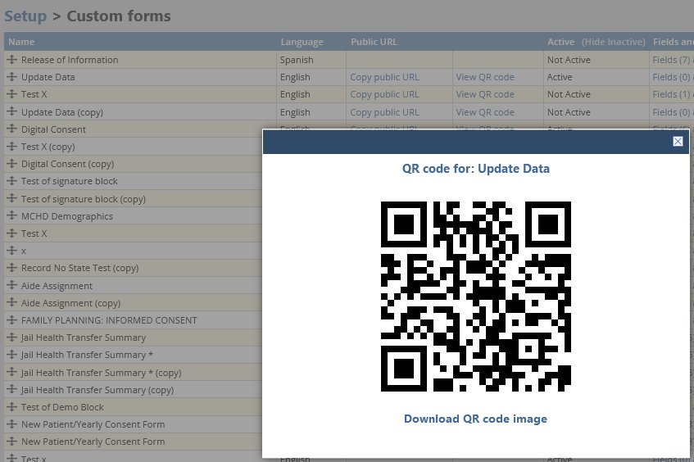
Distributing Custom Forms via QR Code:
Custom forms can be distributed using a QR code. It can be scanned directly from Nightingale Notes, via the “View QR Code” button or downloaded to distribute at the agency’s discretion.

Slide 13
Q & A

Slide 14
Release Dates
Update is currently on staging. Please test if possible, using your production credentials.
https://staging.nightingalenotes.com/
If issues occur on staging, please email support@champsoftware.com and state the issue in detail in the email, with the subject line of “Release Testing.”
Plan for Nightingale Notes to be down from the evening of July 21st until approximately 6:00 am on July 22^{nd.}
Release to Production on
Friday, July 21st, at end of business day

