Slide 1
September Release Overview
Presented by:
Champ Support Staff

Slide 2
Release Includes:
ICD-10 Update for October 1st
Backend Updates
Custom Form Feature Changes (Gold customers only)
HH PPS Grouper Update (Home Care Customers only)
Release Date:
September 29
Nightingale Notes will be unavailable Friday at end of business day

Slide 3
ICD-10-CM Update
The updated code set is to be used for patient encounters and discharges occurring from October 1st, 2023, to September 30th, 2024. With this update, there were:
395 new codes added
25 codes deleted
13 revisions

Slide 4
Backend Updates
Recently, there was an issue in certain cases where some users were not able to log in. We fixed the main issue at the time. We have now made some additional backend improvements in this area to avoid problems in the future.
You should not notice any changes to your functionality. If you do, particularly if you can or cannot do something that you always have been able to, please email support@champsoftware.com and let us know what you are experiencing.

Slide 5
Gold Package Only
Custom Form Updates

Slide 6
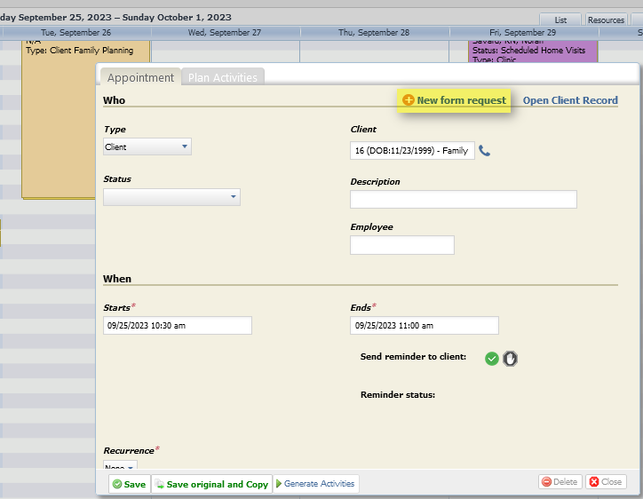
New Form Request Link in Scheduler
On the Appointment screen, there is now a link to send a form to the client you’re setting the appointment up for.
This occurs once you add a client to the appointment.

Slide 7
Manage Custom Forms Screen Updates
New form request link, that will bring up a field to select a client to give/send the forms to. Please note that you cannot add a form to a person until they are a client in Nightingale Notes.
Custom forms setup link, that will open a new tab and take you to the Custom forms screen in setup. This leaves the Manage Custom Forms screen up on the previous tab.
Both options are available on the Inbox and Processed forms pills.

Slide 8
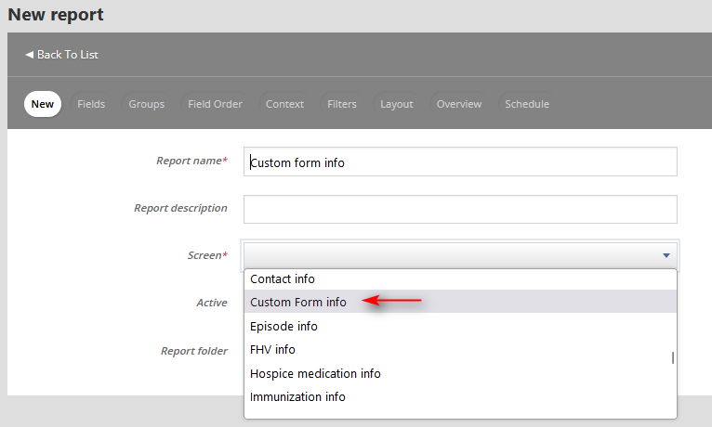
Custom Forms Reporting
In the All Reports screen, there is a new screen called “Custom Form info.”

Slide 9
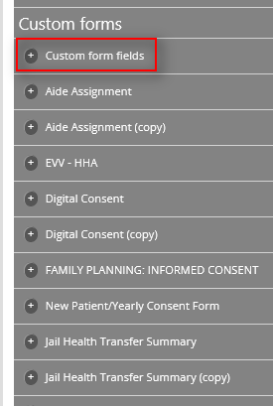
Custom Forms Reporting
This screen contains a Custom Forms section with all the custom forms listed, as well as a special subsection called Custom form fields:

Slide 10
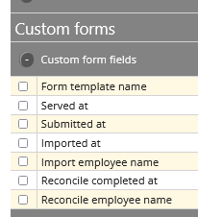
Custom Forms Reporting
This subsection contains “metadata” fields, such as the forms that were sent/given to a client and when it was submitted, and reconciliation information if the form went through the Manage Custom Forms screen.

Slide 11
Custom Forms Reporting
You can also report on any of the custom forms from this screen view. It is highly recommended that you only report on a single custom form at a time.

Slide 12
Custom Forms Reporting
In addition to this special screen, the custom form fields are available from almost all client-related screens, such as Client info, Activity info, etc.
When available on these screens, the only custom forms that will appear are any that have been filled out, so there is client-related data in the reports. In other words, if a custom form has not been used yet, it will not appear in the screen you are using.

Slide 13
Home Care Customers Only

Slide 14
ICD-10-PCS Update
The updated code set is to be used for discharges occurring from October 1st, 2023, to September 30th, 2024.
Information about the update is here: https://www.cms.gov/medicare/coding-billing/icd-10-codes/2024-icd-10-pcs

Slide 15
HH PPS Grouper Update v04.1.23
There is an update to the home health grouper, so OASIS will contain the new version v04.1.23 starting October 1st. For more information about what the update includes, see: https://www.cms.gov/medicare/payment/prospective-payment-systems/home-health/home-health-grouper-software

Slide 16
Q & A

Slide 17
Release Dates
Update is currently on staging. Please test if possible, using your production credentials.
https://staging.nightingalenotes.com/
If issues occur on staging, please email support@champsoftware.com and state the issue in detail in the email, with the subject line of “Release Testing.”
Plan for Nightingale Notes to be down from the evening of September 29th (after business hours) until approximately 6:00 am on September 30th.
Release to Production on
Friday, September 29, at end of business day

