Slide 1
January 2024 Release Overview
Presented by:
Kellie Kopischke

Slide 2
Agenda
Welcome
Recent Dynamsoft Update
Info for Availity Integration Customers
Contents of Release
Q & A
Release Dates and Testing Information
Notes:
Meeting will be recorded and available later today, along with the PPT slides.

Slide 3
Dynamsoft Update
We want to inform you about a security update from Dynamsoft. Dynamsoft’ s Web TWAIN application is used for scanning documents into Nightingale Notes. Dynamsoft reports that they have not received any reports of incidents or attacks related to this security issue. However, they are recommending immediate upgrades for the Dynamsoft Service application that is installed on end-user machines to facilitate scanning.
Dynamsoft has released updated installer packages and Champ Software deployed those to our application recently. Now you will need to update the version installed on your computers that access Nightingale Notes, using the instructions included in this letter.
Whether or not you are currently using the Scanning feature in Nightingale Notes, you need to uninstall the Dynamsoft Service from all devices where it has been installed. Installing the new version is only necessary if you are continuing to use the scanning feature in Nightingale Notes.
Notes:
Meeting will be recorded and available later today, along with the PPT slides.

Slide 4
For Availity Integration Users – Coming Soon…
Ability to have more than one Availity account
For most customers, this will just be a change to what you see in Setup > Pay Sources:
If you have the Availity integration, you’ll see a new field called “Clearinghouse subscription” under the pay source name. If you only have one account, you won’t have to change anything.
If you have two Availity accounts, you’ll need to let Support know what the credentials are for the second account so they can be entered in the backend of Nightingale Notes. Then in the Pay Sources screen, you’ll select the appropriate Availity account to check eligibility, send claims and receive remittances. The payer list will not be available until the appropriate account is selected.

Slide 5
Release Includes
MN IHVE users only: IHVE report updates
Home health agencies only:
HH Grouper update
HH PPS Rate update
Gold Package users only: File attachments in custom forms
Release Date:
December 29th
Nightingale Notes will be unavailable Friday at end of business day until Saturday morning

Slide 6
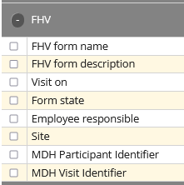
IHVE Report Updates
In the FHV Info screen, there are two new fields:
MDH Participant Identifier
MDH Visit Identifier
You should now also see the participant ID and visit ID on the client’s Overview > FHV tab.

Slide 7
Home Health Updates
The Home Health Grouper has been updated to v05.0.24 for OASIS assessments done January 1st, 2023, or later.
The Home Health Rates have been updated for January 1st and later claims.
More information about both updates is available in the release notes.

Slide 8
Gold Package users only: File attachments in custom forms
Before you can use the feature, you’ll need to contact Champ Support and ask us to enable file attachments in custom forms for you.

Slide 9
Gold Package users only: File attachments in custom forms
In Setup > Custom Forms, go to the Fields and Blocks pill, then click on New Block. Click on Block type and select “File attachment from the bottom of the list. Add info to the following fields:
Block name
Label text for the file upload area – This is the text that the user will see, so it would be good to include instructions on what the field is for.
File attachment prefix – Incoming patient files will be renamed using this prefix together with a timestamp. Valid prefixes only contain letters, numbers, underscores and hyphens.
You can also add a File attachment category, which will be added to the file.

Slide 10
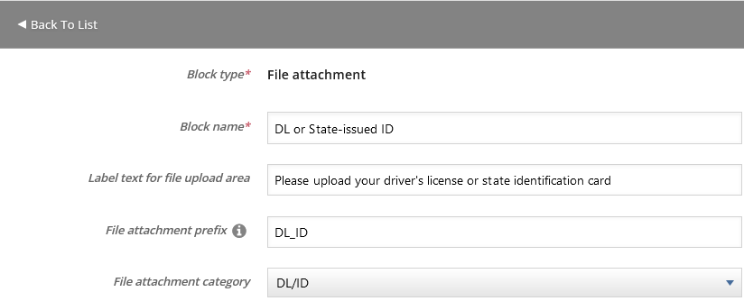
Gold Package users only: File attachments in custom forms
In Setup:

Slide 11
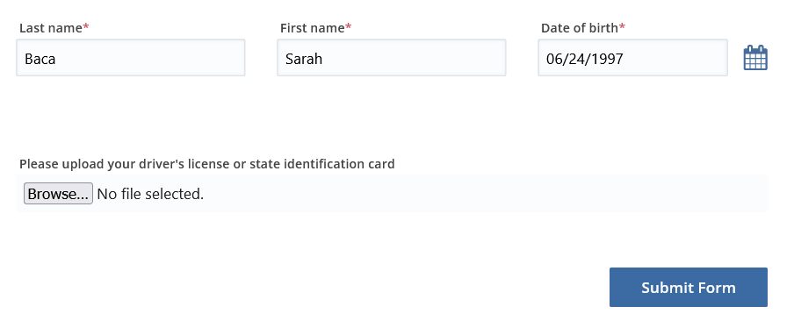
Gold Package users only: File attachments in custom forms
In the form:

Slide 12
Gold Package users only: File attachments in custom forms
:

Slide 13
Gold Package users only: File attachments in custom forms
After the form and attachment are downloaded, you can click on View to view the attachment or Manage, which will take you to the client’s Files screen

Slide 14
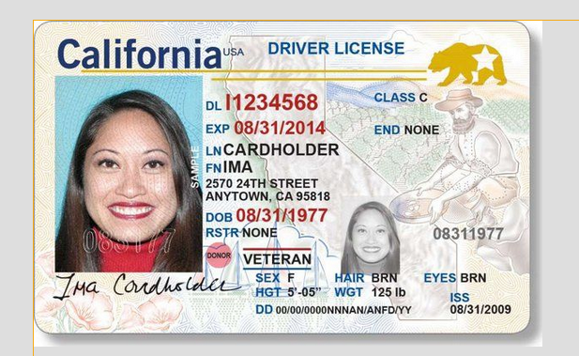
Gold Package users only: File attachments in custom forms
Viewing:

Slide 15
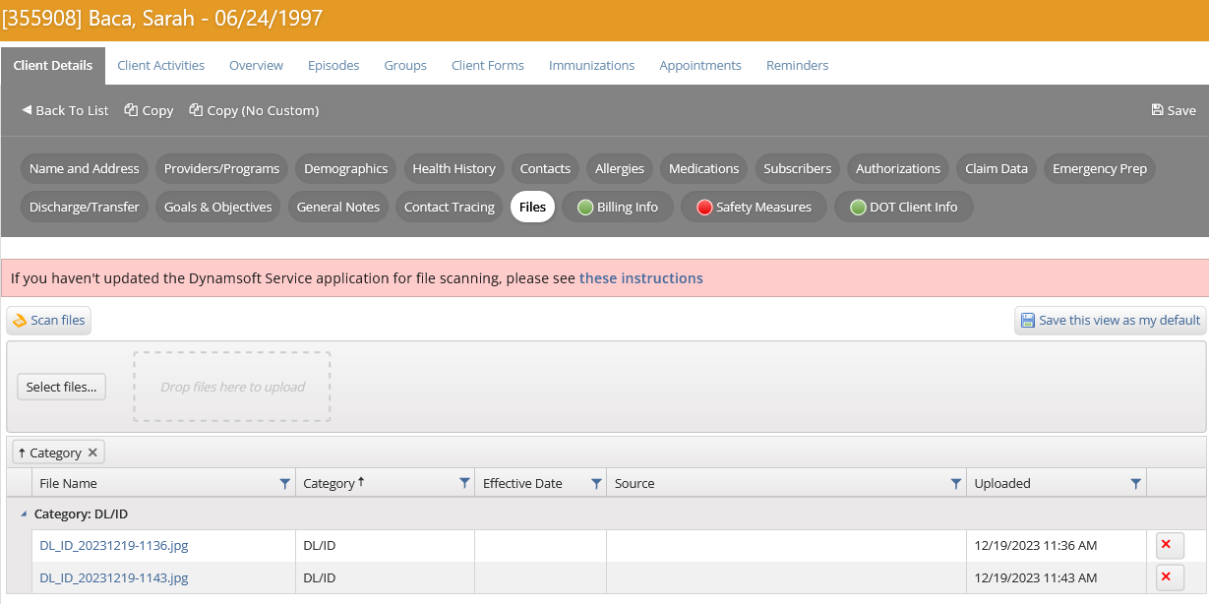
Gold Package users only: File attachments in custom forms
Managing:
Notes:
You can see how it named the file, with a prefix that agency selects, as well as the category.

Slide 16
Gold Package users only: File attachments in custom forms
If the file was uploaded via public URL and you use the Manage Custom Forms screen to import the form into Nightingale Notes, the file will also be pulled into Nightingale Notes and it will be uploaded to the Files tab at the Client Details level.
Notes:
You can see how it named the file, with a prefix that agency selects, as well as the category.

Slide 17
Q & A

Slide 18
Release Dates
Update is currently on staging. Please test if possible, using your production credentials.
https://staging.nightingalenotes.com/
If issues occur on staging, please email support@champsoftware.com and state the issue in detail in the email, with the subject line of “Release Testing.”
Plan for Nightingale Notes to be down from the evening of December 29th (after business hours) until approximately 6:00 am on December 30th.
Release Date:
December 29th
Nightingale Notes will be unavailable Friday at end of business day until Saturday morning

